Slide 1
Introduction to Software Engineering Practices
National Central University Intelligent Systems Software Lab

Slide 2
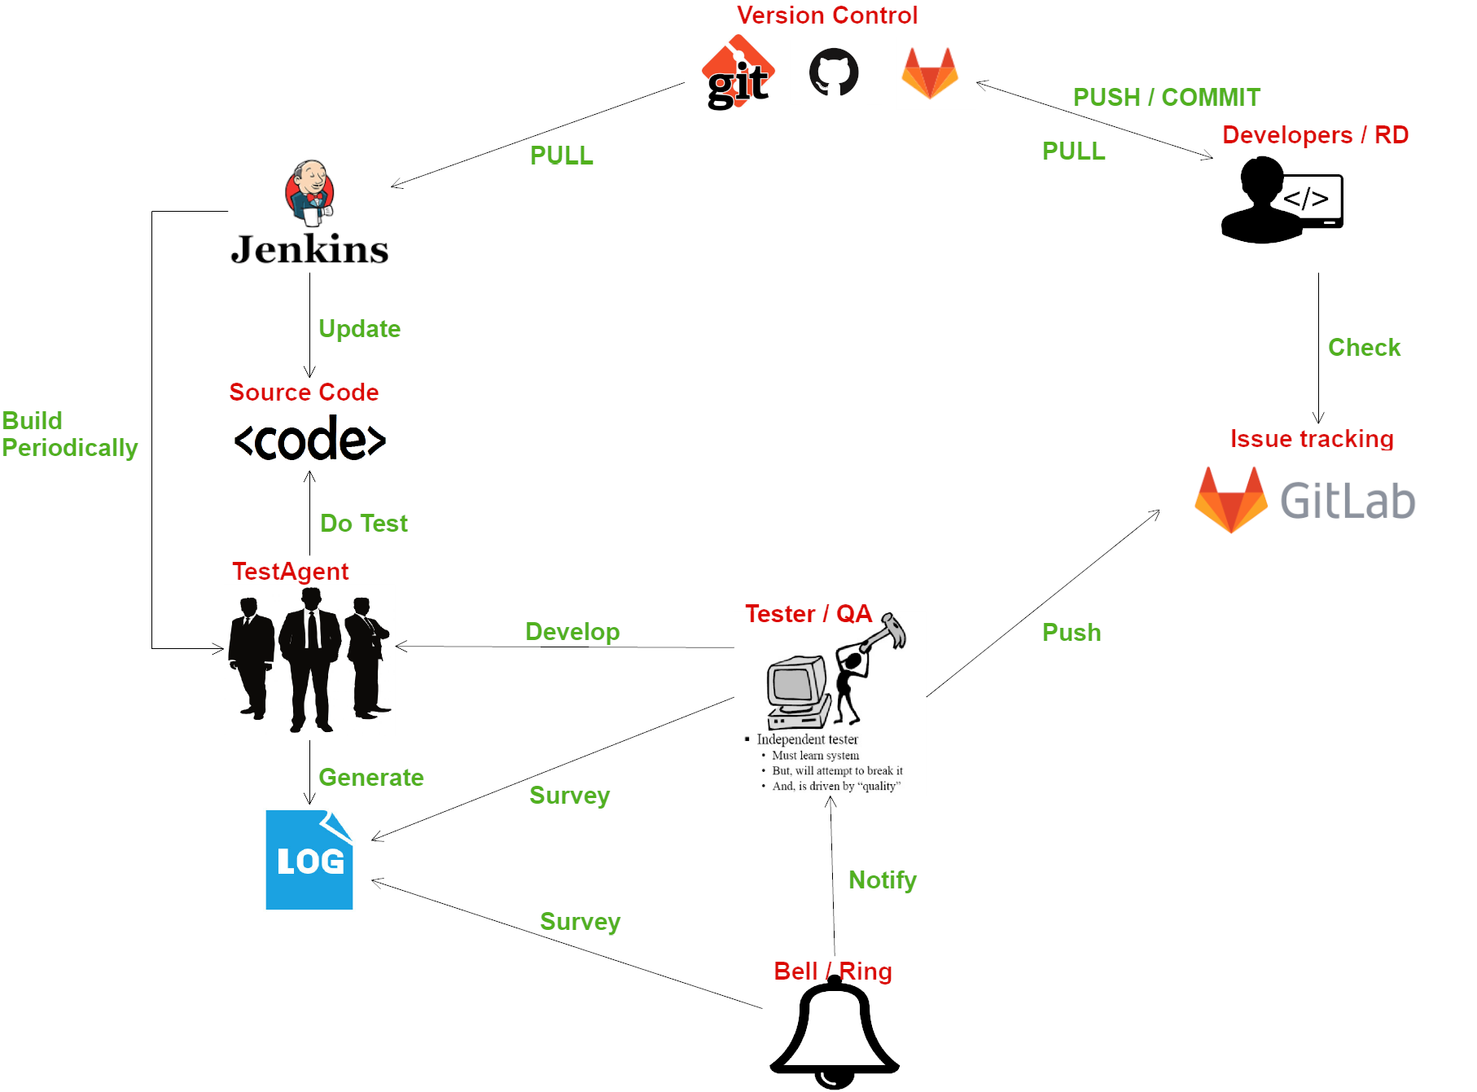

Week 1 & Week 3
Week 2 & Week 5
Week 4
Syllabus

Slide 3
Software Engineering Practices Syllabus
Week 1: Debugging Tool
Homework: Using debugging tools and code tracing
Week 2: System Test, Test Plan
Lab: Jenkins, KORAT (Automatic GUI testing tool)
Week 3: Multithreading coding, testing and debugging & tough bugs
Homework: Release Bugs (core dump), race condition debugging
Week 4: Unit Test (Junit)
Homework: Test stub, mock
Week 5: Code Quality with Code Review
Lab: Revision Control (git), Gitlab and Issue Tracking
Term project (Group Work & Bring Your Own Project)

Slide 4
Week 2 - Test Plan Test Cases
Even a simple a+b function with 32-bit integers needs 2³² * 2³² = 2⁶⁴ = 1,884,744,073,709,151,616 test cases, taking 600 years to complete if we can do one test per nanosecond.
We have to do selective testing!
1.null user ID
2 Qualified ID
(lower bound)
3. Qualified ID
5. Duplicated ID
4. Qualified ID
(upper bound)
6. not qualified ID
empty
In the specified range
not qualified
length < 1 | length >= 1 and length <= 6 | length > 6
0
1
4
4
6
7
Test data: C Bill Nill Office William (empty string)
qualified but duplicate

Slide 5
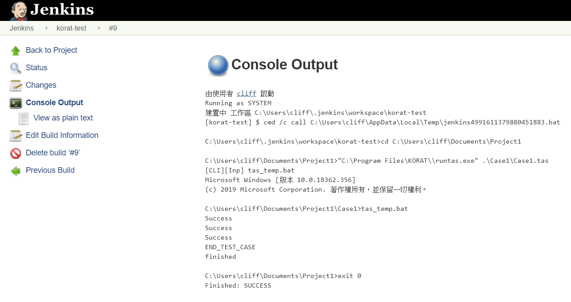
Week 2 - System Test Jenkins
An open source automation server which can be used to automate all sorts of task related to building, testing and delivering or deploying software.

Slide 6
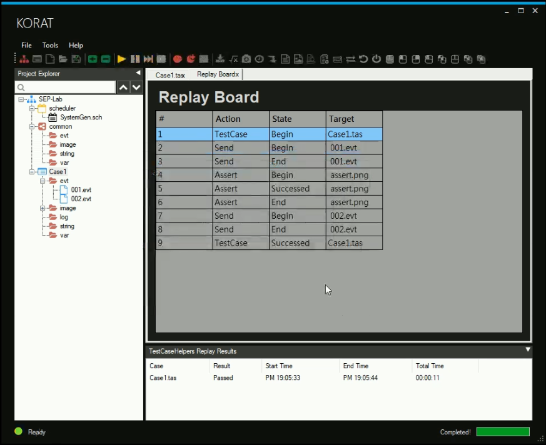
Week 2 - System Test KORAT
A set of capture / replay test automation tools
Can record what you do when testing your SUT (System Under Test)
It can be replayed in the future to save manual and tedious repetitive

Slide 7
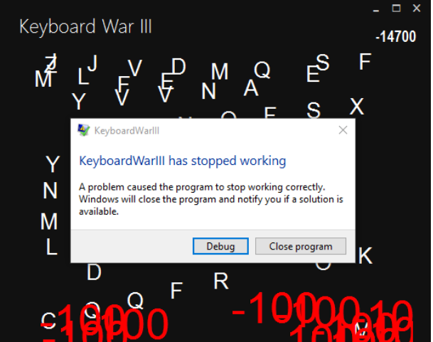
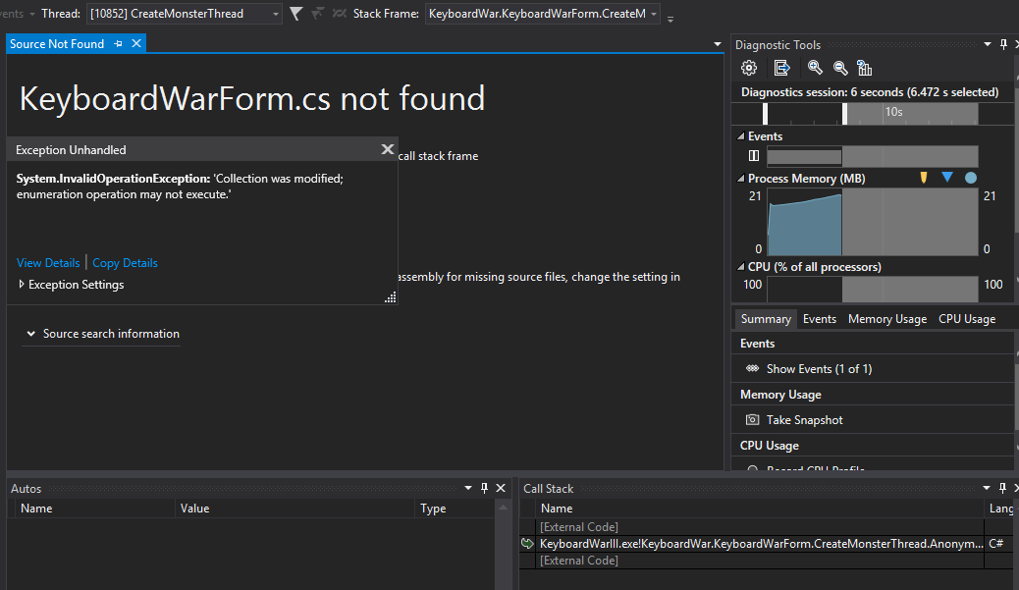
Week 3 - Release bug and Tough bugs Advanced debugging
Debugging a multi-threaded GUI program with or without source code
Collect information for debugging without accessing end-user’s computer directly

Slide 8
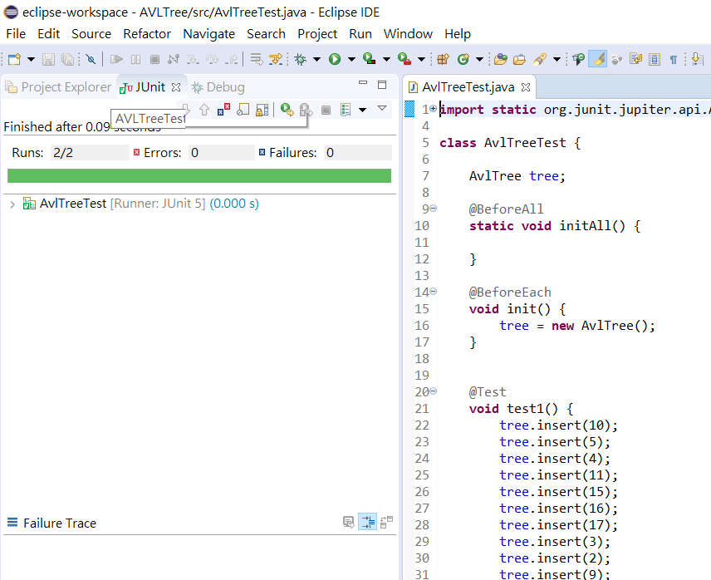
Week 4 Unit test (JUnit)
Unit tests are tested in units of functions in objects
The scope of every test is independent and can be performed simultaneously
Tests with smaller range are easier to correct errors accurately and reduce test complexity
Automated Unit tests

Slide 9
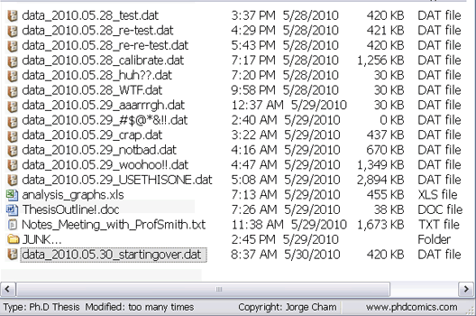
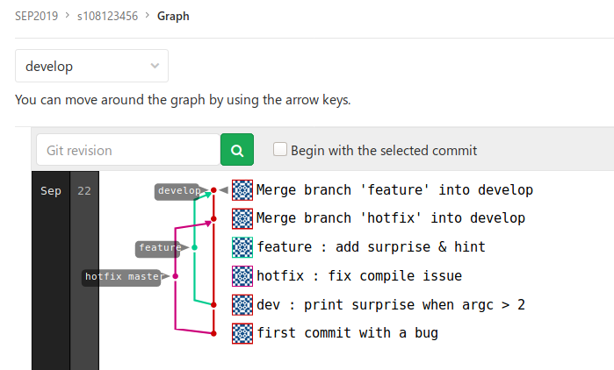
Week 5 Revision Control with git and Gitlab
Managing source code with ease by revision control software

Slide 10
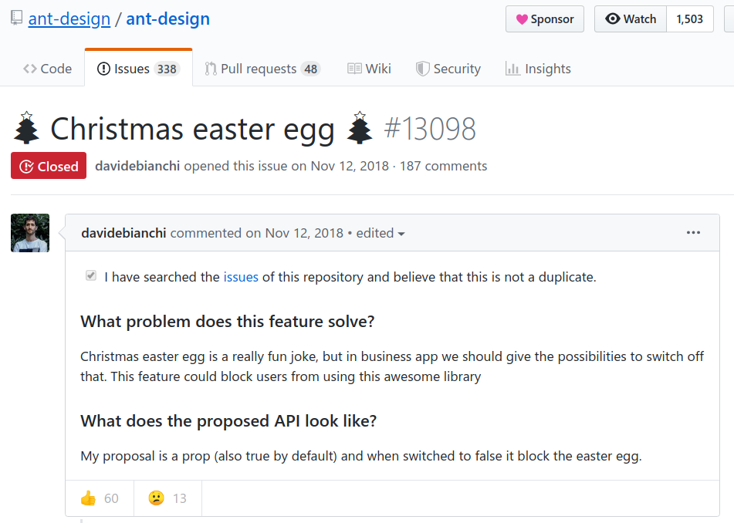
Week 5 Issue Tracking with Gitlab
Communicate with your teammates with effective tools which can trace and record known bugs and issues

